Slide 1

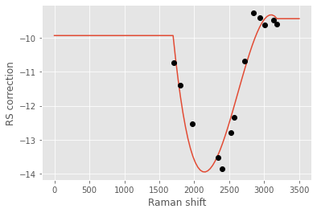
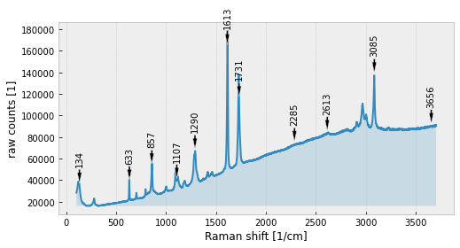
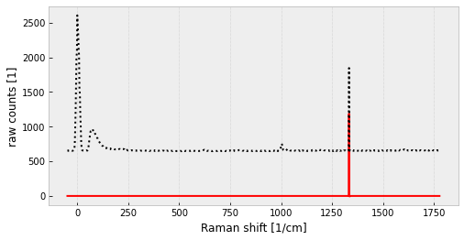
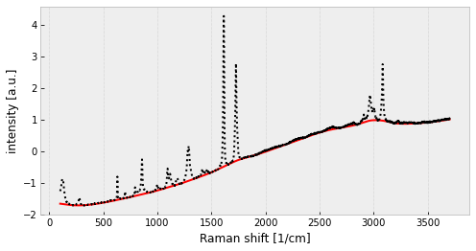
Calibration
Pre-processing
Interpolate to x axis of reference spectrum:
R.interpolate_x(reference_spectrum)
Calibrate x with existing RamanCalibration cal:
R.calibrate(cal)
Show x calibration curve:
cal.show()
Get calibration time / date:
cal.time
Generate x calibration using reference spec:
cal = R.make_x_calibration(ref)
…and consider only peaks in interval:
cal = R.make_x_calibration( ref,1700,3200)
Generate x calibration using peak positions list:
cal = R.make_x_calibration( [202.12,451.76,…,1809.28])
Calibrate y with existing RamanCalibration:
R.calibrate_y(y_cal)
Generate y calibration using reference spectrum:
y_cal = R.make_y_calibration(ref)
Save RamanCalibration to disk:
cal.save(‘C:\cal_filename.chacal’)
Load RamanCalibration from disk:
cal = read_x_calibration(
‘C:\cal_filename.chacal’)
Smooth spectrum using Savitzky-Golay filter:
R.smooth('sg',window=11,order=3)
Normalize spectrum using vector norm:
R.normalize(‘vector’)
Area normalization using only an interval:
R.normalize(‘area',500,1250)
Crop spectrum on the x axis to 500-1.250 cm⁻¹:
R.x_crop(500,1250)
Add spectrum S to R: R.math(S,‘+')
RamanChada
Cheat Sheet
Loading & displaying data
R = RamanChada(‘C:\file.spc’)
Spectrum object info: R
RamanChada with 3526 points generated Wed Sep 15 …
Get metadata as dict: R.meta
Add metadata (dict):
R.add_metadata({‘Power[mW]’:5})
Get processing log as list:
R.log or R.show_log()
Undo last processing step: R.rewind(-1)
Revert to original data: R.rewind(0)
Save .cha file with all changes:
R.commit(‘commit message’)
Load .cha file:
R = RamanChada(‘C:\file.cha’)
Plot spectrum: R.plot()
Get the raw data from the same file:
S = RamanChada(
R.file_path, raw=True)
Peaks search & fitting
Find peaks with prominence>0.2 without fitting:
R.peaks(prominence=0.2,fit=False)
DataFrame with detected/fitted peaks: R.bands
Fit peaks within 2xFWHM w/ Voigt profile & plot:
R.peaks(fitmethod='voigt’, interval_width=2,show=True)
Find peaks using wavelets, fit & sort by position:
R.peaks(cwt=True,sort_by='position’)
Plot spectrum with
peak positions
R.show_bands()
Baseline separation
Batch processing
Cosmic rays
Fit baseline using SNIP method
R.fit_baseline(method='snip’)
Plot baseline model
R.plot_baseline()
Fit and remove baseline
R.remove_baseline(method='snip’)
List of RamanChada objects from path list files:
SL = [RamanChada(f) for f in files]
Normalize all spectra by standard normal variate:
[s.normalize() for s in SL]
Apply Wiener filter to all and then save to disk:
[s.smooth(‘wiener’,7) for s in SL]
[s.commit(‘smoothed’) for s in SL]
Fit x ray model
R.fit_xrays()
Plot x ray model
R.plot_xrays()
Remove x rays: R.remove_xrays()

